Slide 1
CPS-LAB 1
Let’s break the ice.

Slide 2
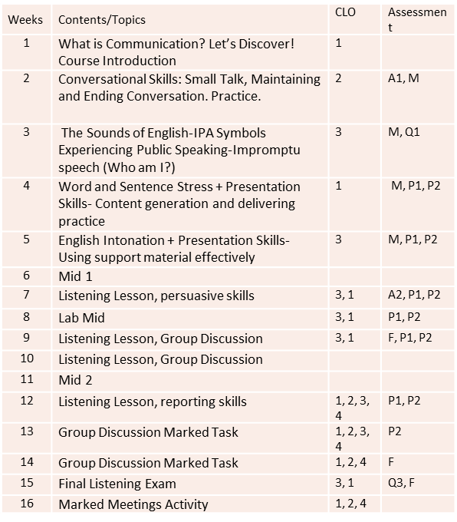
Course Content Spring 2023

Slide 3
Marks Distribution
Particulars | % Marks
1. Mid I | 15%
2. Mid II | 15%
3. Assignments/Quizzes | 10%
4. Project | 10%
6. Final Exam | 50%
Total:- | 100

Slide 4
Important Information
Google classroom code
iej2uvb
My availability:
Preferably on Fridays
8:30 am-11 am
EE Building
1st Floor
Faculty offices, Room 6

Slide 5
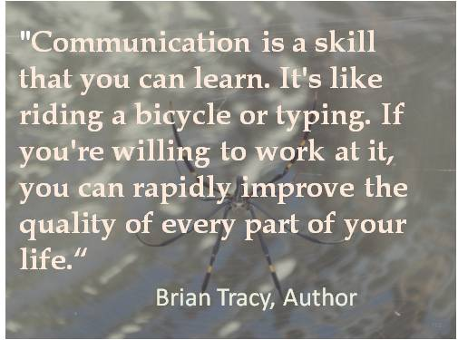
A piece of Advice!

Slide 6
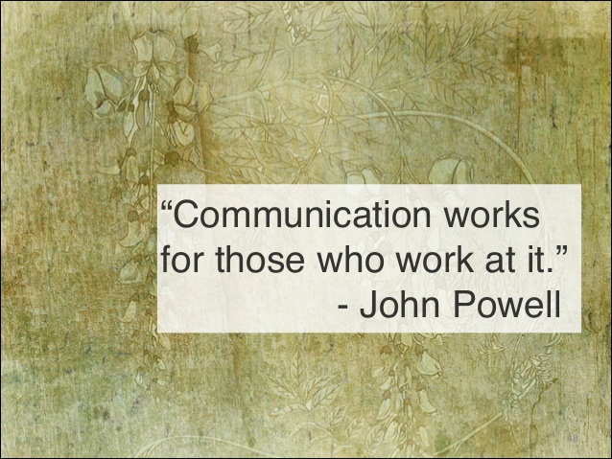
Reflect and Share your thoughts!

Slide 7
Read the given quote and give your opinion.
What is meant by the speaker when he says:
"I know that you believe you understand what you think I said, but I'm not sure you realize that what you heard is not what I meant."
Robert McCloskey

Slide 8
“People don’t get along because they fear each other. People fear each other because they don’t know each other. They don’t know each other because they have not properly communicated with each other.” Martin Luther King Jr.
Read the given quote and give your opinion. Luther king said the following?

Slide 9

Activity 1: Let’s Get to Know each other!
Now each of you would have to speak about, ‘The biggest blunder I made recently’. Make sure it is decent for the classroom context). Talk about it for 1 to 2 minutes only.
Now, divide yourself in pairs.
Your job is to listen to your partner attentively and summarize his/her answer in front of the class.
The class will tell how good a listener you are.

Slide 10
Listener and Talker Activity (Feedback)
The other partner has to stay quiet while the first partner talks, just listening instead of speaking.
After the time is up, the listener has one minute to recap what the speaker said (not agree, disagree, or debate, just recap). End the activity and a discussion with the following questions:
How did speakers feel about their partners’ ability to listen with an open mind? Did their partners’ body language communicate how they felt about what was being said?
How did listeners feel about not being able to speak about their own views on the topic? How well were they able to keep an open mind? How well did they listen?
How well did the listening partners summarize the speakers’ opinions?

Slide 11
Activity 2:
Draw an abstract drawing that shows simple shapes. Keep it hidden from your group members.
Other members of the group will try to recreate this drawing based on verbal instructions from the group leader. Without looking at his piece of paper, the leader will only use spoken instructions
The group leader starts with describing his drawing and instruct others to draw the same. The person who makes the best copy wins.
First draw a medium sized triangle in the middle of the paper.
Next draw a circle on the bottom left of the triangle, slightly touching it.
Lastly draw a rectangle that intersects with the top of the triangle.
At last, the participants will compare their drawings.
Have feedback about the differences in drawings and the communication occurred.
Discuss what went well and were the communication could have been better.
Whole class discussion: Evaluate what you’ve experienced during the activity as a whole class. What could be done to have clear and effective communication?

Slide 12
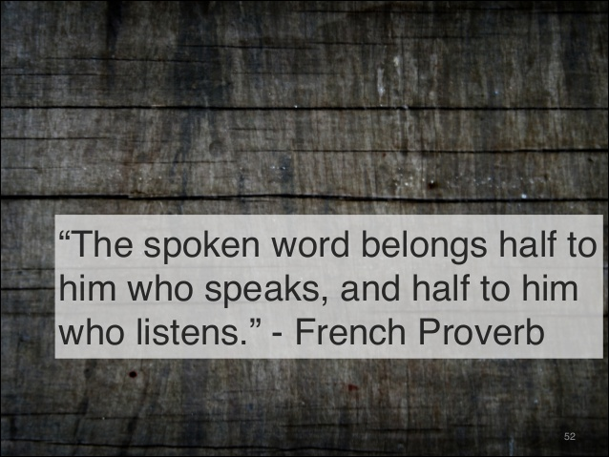
What is the role of listening in Oral Communication?

Slide 13
DEFINITIONS OF COMMUNICATION.
“Communication is any behavior, verbal or non-verbal, that is perceived by another. Knowledge, feelings, or thoughts are encoded and sent from a source and received and decoded by another. A connection is made between the people communicating.”
“Communication is a dynamic process that individuals use to exchange ideas, relate experiences, and share desires through speaking, writing, gesture, or sign language.”

Slide 14
Summarizing the definitions
Technically speaking, in the act of communication, we make opinions, feelings, information, etc. known or understood by others through speech, writing or bodily movement.

Slide 15
The Basic Communication Process:
This eight-step model is a simplified view of how communication works in real life; understanding this basic model is vital to improving your communication skills.

Slide 16
PURPOSE:
Why do we communicate?
The purpose of any given communication may be:
to initiate some action:
Expressing needs and requirements, Persuading and motivating others
b) to impart information, idea, attitudes, beliefs or feelings:
a) Creating awareness
b) Creating understanding
c) Persuading others
d) Influencing others
c) To establish, acknowledge or maintain links or relations:
Core function of communication.

Slide 17
The Essence of Communication
Personal process
Occurs between people
Involves change in behaviour
Means to influence others
Expression of thoughts and emotions through words & actions.
Tools for controlling and motivating people.
It is a social and emotional process.

Slide 18
Features of Communication
Two-way Process
Information Sharing and Understanding
Circular Flow
Goal Oriented
Continuous Process

Slide 19
Formal vs Informal communication.
Formal
Planned communication
Memo, letter, report, e-mail & faxes that follow company’s chain of command etc.
Informal
Casual Communication among employees
e-mail, face to face conversation, phone calls, discussions etc.

Slide 20

Final Take Away!
Communication should not be taken for granted.
It is an art and science that needs to be studied and practiced.
Good speakers and listeners you meet are your constant source of inspiration and learning.
Gear up for mastering communication skills in the business world (they will be fully applicable to personal life as well).

